Slide 1
Water Level Controller System

Slide 2
Introduction
Water management systems have become essential components of smart homes and industries. Traditional manual monitoring methods lead to water overflow and wastage. Automation using digital circuits eliminates this problem.
This project demonstrates a verilog-based water level monitoring system, representing the tank level using digital inputs. Logic is implemented to control a motor based on these inputs.
The verilog code mimics sensor readings from various levels (low, medium, high) and drives the motor automatically, depending on the tank’s water level.
The system can be integrated with embedded or iot controllers for real-time control and monitoring, thus serving as a base for future smart water management systems.

Slide 3
Abstract
Water scarcity and wastage are major challenges in today’s world. An automated water level controller helps conserve water by monitoring and controlling the water level in tanks without human intervention.
In this project, a digital water level controller is designed using verilog hdl to detect and control the filling operation of a water tank based on sensor inputs.
The system turns the motor on when the tank level is low and turns it off when the tank is full, preventing overflow. The circuit is simulated and verified on FPGA or verilog simulation tools such as xilinx ISE or modelsim.

Slide 4
Workflow / Block Diagram
Inputs:low → sensor at bottom (1 = low level detected)
Mid → sensor at mid level (1 = mid level detected)
High → sensor at top (1 = full tank detected)
Output:motor → 1 = ON, 0 = offlogic
Workflow: +-----------------------------+
| water level logic |
+-----------------------------+
| low=1 & high=0 → ON |
| high=1 → OFF |
| else retain prev state |
+-----------------------------+
|
v
[motor output]

Slide 5
METHODOLOGY
Components and inputs
    Inputs (sensors):
      S1 → low-level sensor
      S2 → mid-level sensor
      S3 → high-level sensor
  Output (actuator):
    Motor → controls water filling (on/off
Logic desigs
If all sensors (s1, s2, s3) are low, the tank is empty → motor on
If all sensors are high, the tank is full → motor off
For intermediate levels, the controller decides motor operation based on
Previous status.
This logic is implemented using combinational and sequential verilog logic
To simulate real-world control behavior.

Slide 6
Proposed System
The proposed system automates the process using digital logic control.
Three sensors are used to detect low (l), medium (m), and high (h) water levels.
Based on the sensor readings, the controller operates the motor as follows:when the water level is low, the motor turns on.
When the water level reaches high, the motor turns off.
If the water level is between low and high, the previous state of the motor is maintained.
The design is implemented in verilog hdl, which can be simulated using tools such as modelsim, xilinx ise, or vivado.

Slide 7
Water Level Controller System
ADVANTAGES DISADVANTAGES
Automation of water management
Efficient hardware implementation
Low power consumption
Compact and reliable design
Cost-effective solution
Accurate water level detection
Scalability and modifiability
Fast simulation and testing
Requires hardware knowledge
Limited by sensor accuracy
Initial setup cost
No built-in user interface
Difficult for beginners
Maintenance complexity

Slide 8
Verilog code
/ Smart Water Level Controller
// Developed for Embedded Systems / IoT Simulation
module water_level_controller( input low, mid, high, clk, reset, output reg motor);
always @(posedge clk or posedge reset)
begin
if (reset)
motor <= 0; // Motor OFF on reset
else
begin
if (low && !high)
motor <= 1; // Turn ON motor if tank low
else if (high)
motor <= 0; // Turn OFF motor if tank full
else
motor <= motor; // Maintain previous state
end
end
endmodule

Slide 9
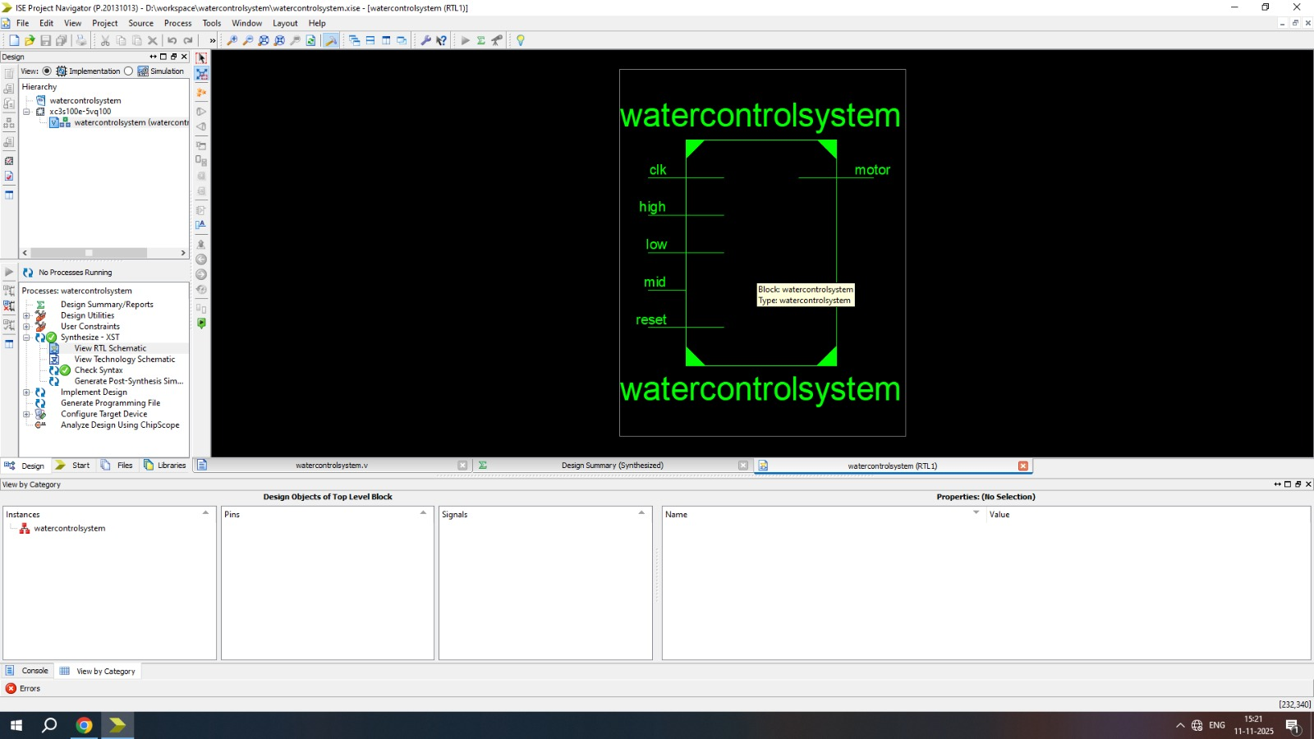

Slide 10
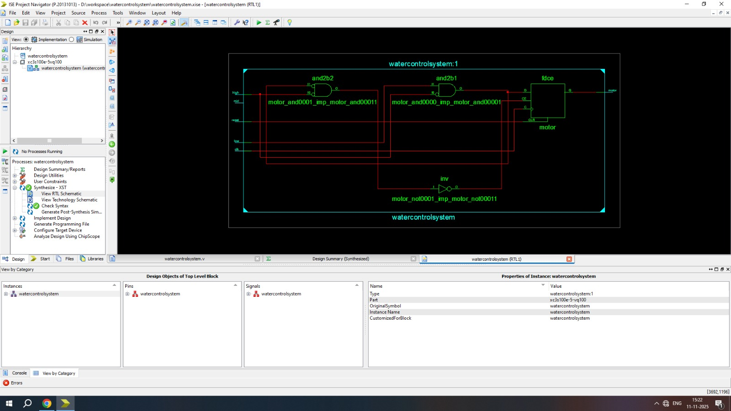
RTL schematic of water controller system

Slide 11
Ieee reference
Kaniskaa M. S., Madanagopal C., Deepa M., Hariprasath K.
“Water level controller with weather forecasting using 8051 microcontroller,”
2023 7th international conference on electronics
Communication and aerospace technology (ICECA), 22-24 nov 2023

Slide 12
Conclusion
This project successfully demonstrates the use of verilog HDL for embedded automation.
The smart water level controller is simple yet efficient, ideal for real-time applications and academic demonstrations. It reflects key IEEE domains such as iot, embedded systems, and smart automation.

Slide 13
Thank you

